Slide 1

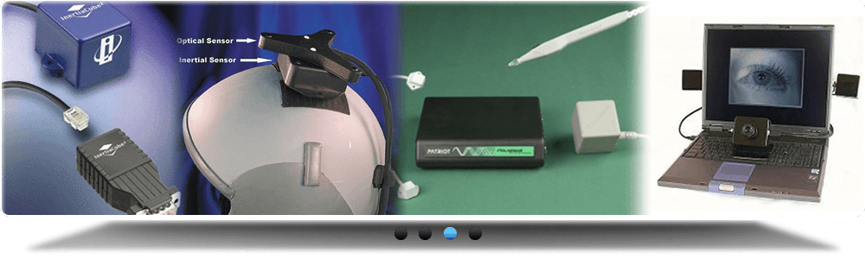
www.studymafia.org
Seminar
On
Virtual Reality
Submitted To: Submitted By:
www.studymafia.org www.studymafia.org
Notes:
1

Slide 2
Content
Introduction
History
Principle
Components
Types
Architecture of VR System
Application
Advantages
Disadvantages
Conclusion

Slide 3

INTRODUCTION
What is Virtual Reality(VR)?
Virtual Reality refers to a high-end user interface that involves real-time simulation and interactions through multiple sensorial channels.
.
Why VR?
VR is able to immerse you in a computer-generated world of your own making: a room, a city, the interior of human body. With VR, you can explore any uncharted territory of the human imagination.

Slide 4

Brief History
In 1950s, flight simulators were built by US Air Force to train student pilots.
In 1965, a research program for computer graphics called “The Ultimate Display” was laid out.
In 1988, commercial development of VR began.
In 1991, first commercial entertainment VR system "Virtuality" was released.

Slide 5
Principle
The Virtual Reality System works on the following principle - It tracks the physical movements in the real world, then a rendering computer redraws the virtual world to reflects those movements.
The updated virtual world is sent to the output (to the user in the real world).
In this case, the output is sent back to a head mounted display.
Hence, The user feels "immersed" in the virtual world - as if she was in the virtual world itself as all she can see is her rendered movements in the virtual world.

Slide 6
components of virtual reality systems
REALITY ENGINE
HEAD MOUNTED DISPLAY (HMD)
AUDIO UNITS
GLOVES

Slide 7

Reality engines
Reality engines are based largely on the same components that make up a personal computer (PC), although much more computing power is required for the reality engine than is available in a standard PC.
Virtual reality images are made with tiny dot like segments of a picture known as pixels, or picture elements.
Each pixel itself is made up of hundreds of thousands of dots. Realistic images can be either opaque, in which all the viewer sees is the virtual world, or see-through, in which the virtual image is projected or superimposed onto the outer world

Slide 8
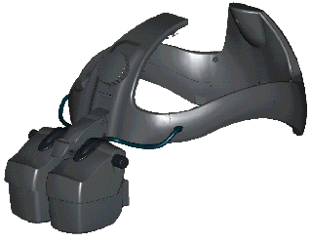
HEAD MOUNTED DISPLAY
Head-mounted display (HMD) units use a small screen or screens (one for each eye) that are worn in a helmet or a pair glasses. Unlike a movie, where the director controls what the viewer sees, the HMD allows viewers to look at an image from various angles or change their field of view by simply moving their heads. HMD units usually employ cathode-ray tube (CRT) or liquid crystal display (LCD) technology.
CRTs incorporate optic systems that reflect an image onto the viewer's eye. Although more bulky and heavy than LCD displays, CRT systems create images that have extremely high resolutions, making a scene seem that much more realistic. civilian/commercial (medicine, video gaming, sports, etc.).

Slide 9

AUDIO UNITS
The audio portion of virtual reality is transmitted through small speakers placed over each ear. Audio cues may include voices, singing, thud like noises of colliding objects—in short, any sound that can be recorded.
Sounds that seem to come from above, below, or either side provide audio cues that mimic how sounds are heard in the real world. Three-dimensional (or omnidirectional) sound further enhances the virtual reality experience.

Slide 10
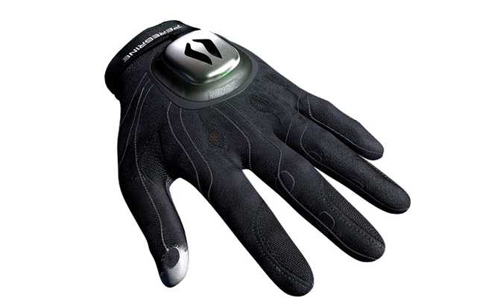
GLOVES
Gloves in virtual reality allow the user to interact with the virtual world. For example, the user may pick up a virtual block, turn it over in a virtual hand, and set it on a virtual table.
Wired with thin fiberoptic cables, some gloves use light-emitting diodes (LEDs) to detect the amount of light passing through the cable in relation to the movement of the hand or joint.
The computer then analyzes the corresponding information and projects this moving hand into the virtual reality. Magnetic tracking systems also are used to determine where the hand is in space in relation to the virtual scene.

Slide 11
Types of Virtual Reality
Hardware
Primary user input interfaces
Tracking interfaces
Visual interfaces
Auditory interfaces
Haptic interfaces
Olfactory interfaces
Software
Input Process
Simulation Process
Rendering Process
World Database

Slide 12
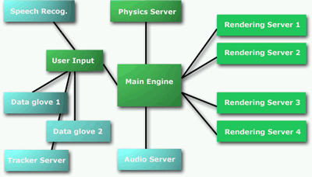
Architecture of VR System
Input Processor, Simulation Processor, Rendering Processor and World Database.

Slide 13
Applications of Virtual Reality
Entertainment
More vivid
Move exciting
More attractive
Medicine
Practice performing surgery.
Perform surgery on a remote patient.
Teach new skills in a safe, controlled environment.

Slide 14
Applications of Virtual Reality
Manufacturing
Easy to modify
Low cost
High efficient
Education & Training
Driving simulators.
Flight simulators.
Ship simulators.
Tank simulators.

Slide 15
Advantages
Many different fields can use VR as a way to train students without actually putting anyone in harm's way. This includes the fields of medicine, law enforcement, architecture and aviation. VR also helps those that can't get out of the house experience a much fuller life.
These patients can explore the world through virtual environments like Second Life, a VR community on the Internet, exploring virtual cities as well as more fanciful environments like J.R.R. Tolkien's Middle Earth.
VR also helps patients recover from stroke and other injuries. Doctors are using VR to help reteach muscle movement such as walking and grabbing as well as smaller physical movements such as pointing. The doctors use the malleable computerized environments to increase or decrease the motion needed to grab or move an object.
This also helps record exactly how quickly a patient is learning and recovering.

Slide 16
Disadvantages
The hardware needed to create a fully immersed VR experience is still cost prohibitive. The total cost of the machinery to create a VR system is still the same price as a new car, around $20,000.
The technology for such an experience is still new and experimental. VR is becoming much more commonplace but programmers are still grappling with how to interact with virtual environments.
The idea of escapism is common place among those that use VR environments and people often live in the virtual world instead of dealing with the real one.
This happens even in the low quality and fairly hard to use VR environments that are online right now. One worry is that as VR environments become much higher quality and immersive, they will become attractive to those wishing to escape real life. Another concern is VR training.
Training with a VR environment does not have the same consequences as training and working in the real world. This means that even if someone does well with simulated tasks in a VR environment, that person might not do well in the real world.

Slide 17
Current problems & Future work
Cybersickness / simulator sickness
Low-fidelity
Expensive
Lack of integration between application packages
High-fidelity system
Cost-saving
Collaborative
High-level contact between participants in distributed VR

Slide 18
Conclusion
VR introduces a new way of interacting with computers
The best of VR is yet to come
Web is very suitable for VR applications, but the proper technology is not yet there

Slide 19
References
Roof calculator-software,calculates & tracks materials, estimates Put a roofing estimate together in under 2 minutes and get a complete roof material list ! 3d Animation UK Studios creating Virtual Reality Pictures UK 3D Animation company has a Computer Graphics portfolio that includes UK Architectural Rendering, UK Product Visualisation, 3D Virtual Tours. Aarkid 3d presentations Virtual tours to highlight your products' unique features CAD Drafting Services www.dp-draftingservices.com specializes in cad drafting services and raster to vector (R2V) conversions for all types of HVAC, architectural, mechanical and engineering projects. CadCells.com - Cells and Custom User Interfaces For Microstation J,v8 and AutoCAD Users Provides Microstation cell libraries for J and v8, AutoCAD, cad libraries.

Slide 20
Thanks..!!!!

